Slide 1
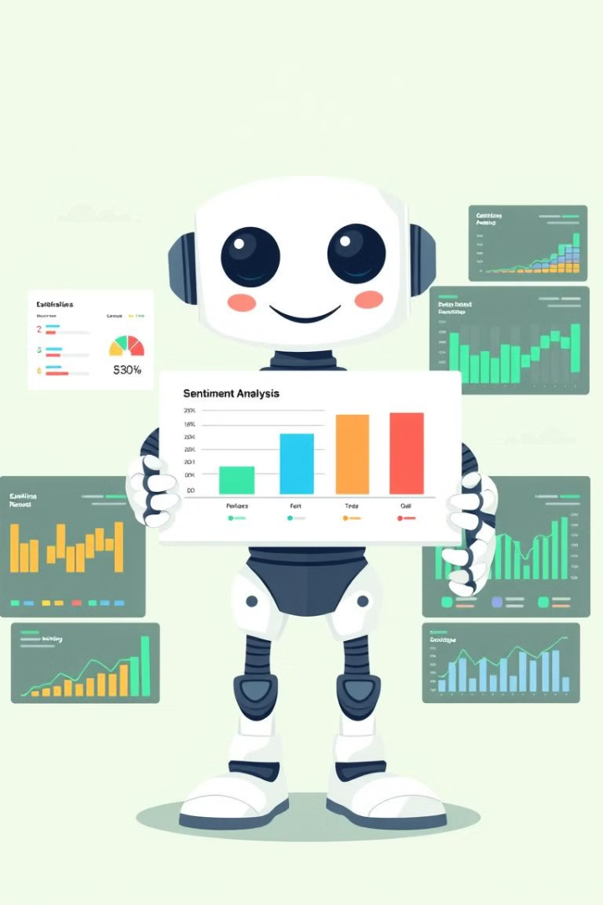
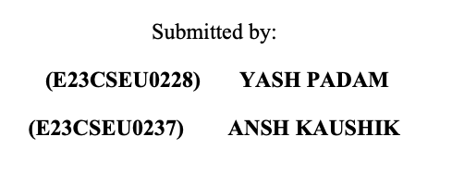

Sentiment Analysis: A Powerful Tool for Machine Learning
Unlock the power of sentiment analysis, a crucial technique in machine learning, to uncover insights from textual data.

Slide 2

Introduction to Sentiment Analysis
1
What is Sentiment Analysis?
2
Importance in Machine Learning
Analyzing text to determine the underlying emotions or opinions.
Enables understanding of customer feedback, social media trends, and more.
3
Applications Across Industries
From customer service to product development, sentiment analysis has wide-reaching impact.

Slide 3
Understanding Sentiment: Positive, Negative, and Neutral
Positive Sentiment
Negative Sentiment
Neutral Sentiment
Conveying approval, satisfaction, or optimism.
Expressing disapproval, dissatisfaction, or pessimism.
Neither positive nor negative, conveying objectivity.

Slide 4





Applications of Sentiment Analysis
Customer Service
Marketing
Enhance customer experiences and address concerns.
Gauge campaign effectiveness and adjust strategies.
Product Development
Social Media
Identify areas for improvement based on user feedback.
Monitor brand reputation and public sentiment.

Slide 5

Data Collection and Preprocessing
1
Data Sourcing
Gather text data from online reviews, social media, surveys, and more.
2
Data Cleaning
Remove noise, handle misspellings, and standardize formatting.
3
Text Preprocessing
Tokenize, lemmatize, and apply other natural language processing techniques.

Slide 6
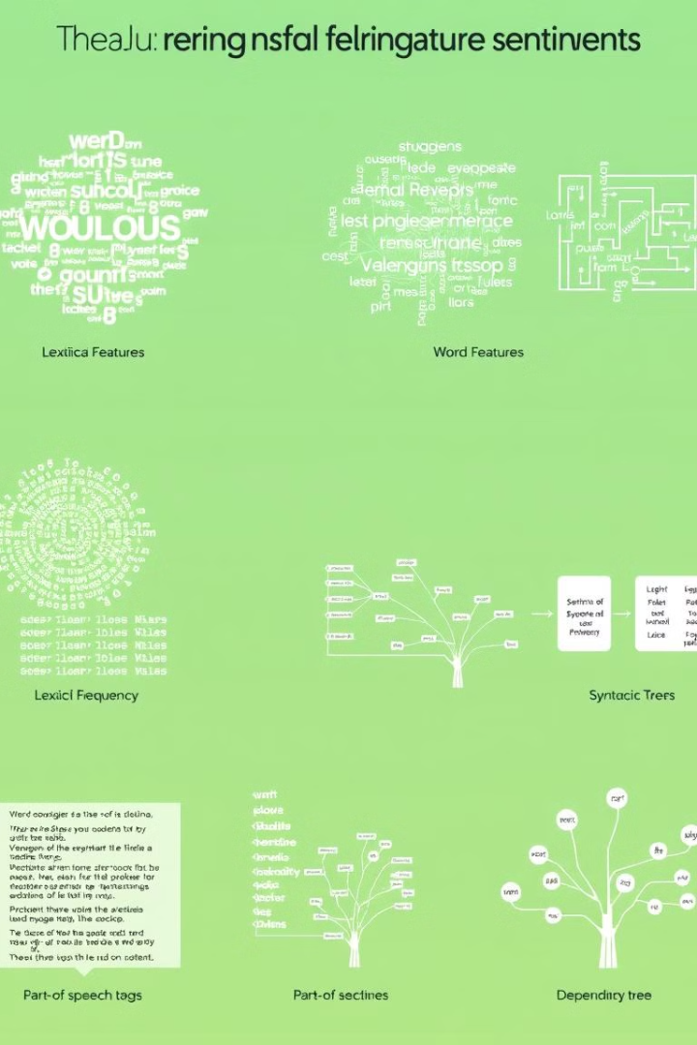
Feature Extraction and Selection
Lexical Features
Syntactic Features
Analyze word choice, n-grams, and sentiment lexicons.
Examine sentence structure, punctuation, and grammatical patterns.
Semantic Features
Feature Selection
Leverage context, word embeddings, and knowledge bases.
Identify the most informative features for sentiment classification.

Slide 7
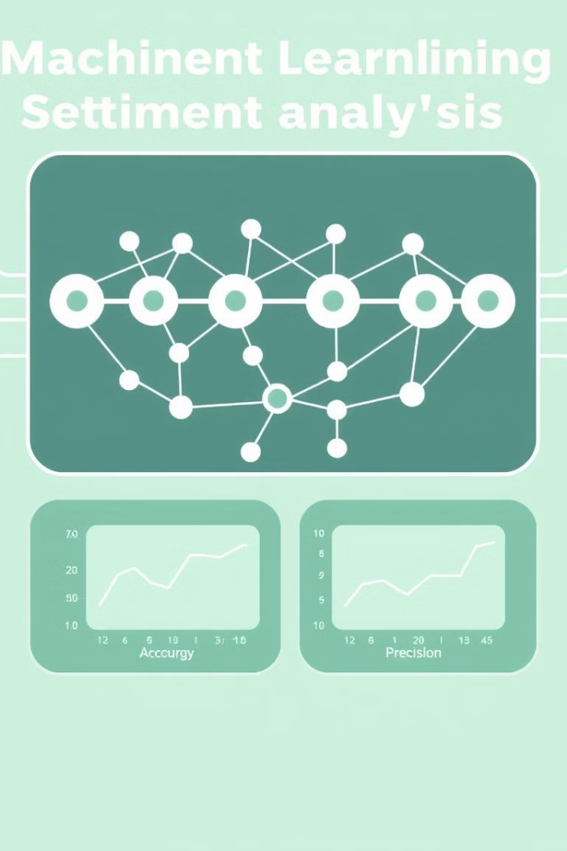




Machine Learning Algorithms for Sentiment Analysis
Naive Bayes
Simple and effective for text classification.
Logistic Regression
Handles both linear and non-linear relationships.
Support Vector Machines
Powerful for high-dimensional text data.
Deep Learning
Leverages neural networks for advanced sentiment understanding.

Slide 8
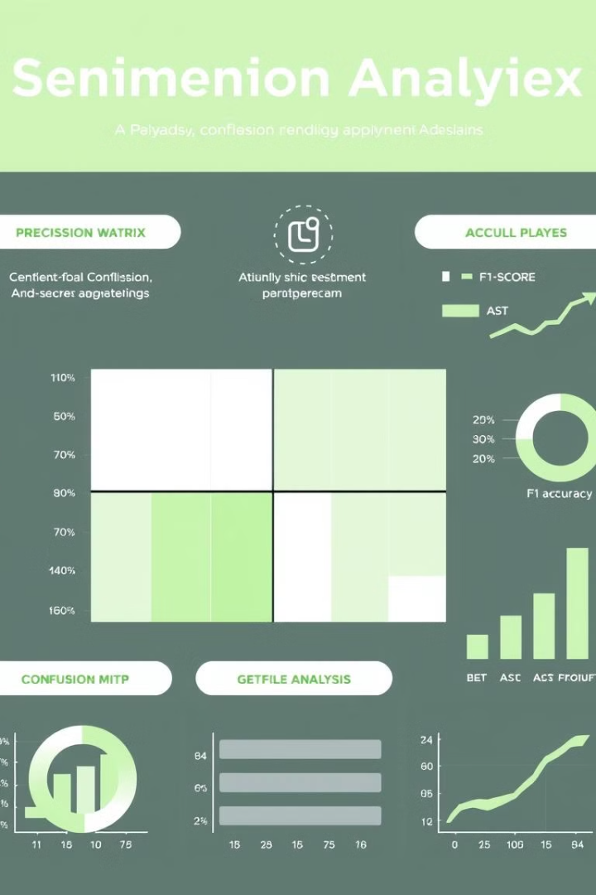
Evaluation Metrics and Techniques
Accuracy
Overall correctness of the model.
Precision
Proportion of true positives among all positive predictions.
Recall
Proportion of true positives among all actual positive cases.
F1-Score
Harmonic mean of precision and recall.

Slide 9


Challenges and Limitations in Sentiment Analysis
1
Context Dependency
2
Multilingual Support
Accurately interpreting sentiment in complex or ambiguous text.
Extending sentiment analysis to diverse languages and cultural contexts.
3
Sarcasm and Irony
4
Bias and Fairness
Detecting and handling non-literal expressions of sentiment.
Mitigating unintended biases in training data and models.

Slide 10



Future Trends and Opportunities in Sentiment Analysis
Multimodal Sentiment Analysis
Advances in Deep Learning
Expanding Applications
Unlocking more nuanced and contextual sentiment analysis.
Applying sentiment analysis to new industries and use cases.
Leveraging diverse data sources for richer sentiment understanding.
Sentiment analysis continues to evolve, offering exciting opportunities to drive innovation and impact across various domains.

